Slide 1
Effective Job Coaching & Fading Strategies
Corey Smith
Griffin Hammis Associates
October 6, 2017

Slide 2
Effective Training
https://www.youtube.com/watch?v=4b8qk3zpops

Slide 3
Types of Learning
Cognitive = Knowledge
Psycho-Motor = Skill’s
Affective/Cognitive = Belief’s/Values
Competent =Confident = More Competent = More Confident =

Slide 4
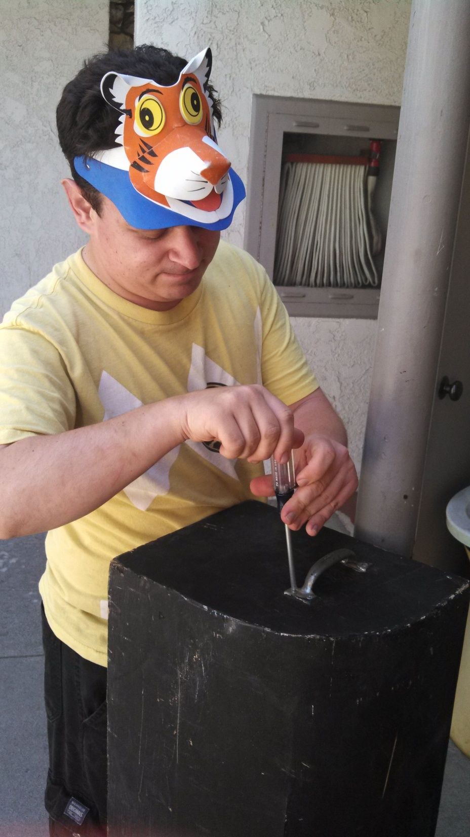
Systematic Instruction

Slide 5
Tim’s Systematic Instruction
Learning to use a screw driver
Power Drill
Projector
Vacuuming
Sweeping
Setting up the stage & lobby areas
Laundry
Ironing

Slide 6
There are not short cuts!!!

Slide 7
“Communication is the Problem to the Answer” 10 CC
More people lose jobs based on ineffective communication strategies and and social skills.
All behavior is a form of communication
The concept of competence deviance
Why do people behave differently in different environments?
Using communication devises and teaching coworkers how to assist

Slide 8
Assistive Technology

Slide 9
Doing a Job Analysis during the Informational Interview

Slide 10
Identifying the “What”
Going beyond jobs tasks themselves
Company Culture
Company Ritual’s
Co-worker interactions
Insights on supervisor-staff relationships
Pace & structure of the work day

Slide 11
Work Culture???

Slide 12
The Job Analysis Record (JAR)
Tool for identifying what to teach
Capture tangible and intangible elements of job, e.g.:
Tasks, performance & quality measures
Rituals, natural trainers, “go to” people
Writing it down is best safety net for not overlooking critical components

Slide 13
JAR When to Use
Use the JAR as a foundation for:
Negotiating a job
Assessing what to teach once job has been secured

Slide 14
Goodness of Fit
Critical Consideration
Must be based on:
Knowledge of Individual, and
Knowledge of Job/Company/Culture
Best instruction in the world can’t overcome a bad fit

Slide 15
JAR: Key Components
Project oriented
Developed for all work routines:
Core
Episodic
Job-related
Task steps should:
Reflect natural instruction
Be verified by supervisory/co-workers

Slide 16
The Job Analysis Record (JAR)
Tool for identifying what to teach
Capture tangible and intangible elements of job, e.g.:
Tasks, performance & quality measures
Rituals, natural trainers, “go to” people
Writing it down is best safety net for not overlooking critical components

Slide 17
Core Routines
Repeating cycles
Performed most frequently during work day
End of one cycle signals start of next
Typically easiest to master
(Callahan & Garner, 1997)

Slide 18
Episodic Routines
Have cycles/specific steps
Performed less frequently during day or week
Less opportunity to practice
Typically more difficult

Slide 19
Customized Tasks @ Training

Slide 20
Task Analysis
Break down a task into its component parts (teachable steps)
Steps listed in sequence first to last
Perform listed steps to assess accuracy & completeness

Slide 21
Facilitating Worksite Support
Presume Discovery & Job Match
“Ecological Fit”
“Your New Employee” sets Expectations of the Employer
Goal is to Augment the Natural Trainer’s Efforts

Slide 22
Facilitating Worksite Support: Job Analysis
Before The New Employee Begins Working:
Observe the tasks being performed by workers
Learn each task you will have to teach
Prepare Task Analyses, Checklists & possible assistive tech
Review with Employer & Natural Trainer for Refinement & Permissions

Slide 23
Facilitating Worksite Support: Job Analysis
Observe to identify potential Natural Support
Observe Intersecting Tasks
Use the Job Analysis Record (JAR)
Break Tasks into Discrete “Jobs” or “Projects” and teach accordingly
Learn the Tasks but decide with Employer who should initially Teach
Regardless, learn the Tasks

Slide 24
Facilitating Worksite Support: Job Analysis
Note that not all Tasks need a TA
Note that not all Tasks are as important as Others
Note that not all Tasks have specific Performance Requirements or Expectations
If unsure, be sure to Ask
Always consider the needs of the Learner

Slide 25
Facilitating Worksite Support: Work Support
Prep for Day One:
Clarify everyone’s role for Day One/Week One
Get Schedule, hours, pay in writing (an email will do)
If planning to modify Typical Means & Methods, negotiate before Day One if possible
Make it known clearly that your role is to support & fade

Slide 26
Facilitating Worksite Support: Work Support
Day One/Week One:
If Needed, Re-Clarify everyone’s role
Review Schedule & any Modifications with Employer & Employee
Review & Update modifications to Typical Means & Methods
Discuss/Adapt Performance & Expectations with Employee & Employer

Slide 27
Facilitating Worksite Support: Work Support
Support both the Trainer & the Trainee
Fit in: dress, breaks, cell phone off
Design & Perform tasks as closely to the business norm as possible
Use Systematic Instruction & Minimize Reward/Verbals!
You are not the Supervisor

Slide 28
Facilitating Worksite Support: Work Support
Work Support (and Long Term Support) is usually determined thru Assessment
Self-Support methods: having strong social bonds; facilitate inclusion in worksite that matches the person; the use of assistive tech from simple checklists to recorders to Apps to labor-saving equipment….

Slide 29
Facilitating Worksite Support: Work Support
Work Support often requires Negotiation of:
Job Tasks & Methods (Functional Vs Topographic)
Hours & Pay (Modified work day due to accessible transit schedule)
Support and Supervision (May need new tasks taught differently)
Health & Safety (Seizure awareness; food allergy awareness)

Slide 30
Facilitating Worksite Support: Work Support
Work Support Scenarios:
Luis is responsible for stocking the Supply Room Inventory. He often finishes stocking a product & then stops, not recalling what to do next. His speech is difficult to understand so he gets frustrated when asking for help. Possible Solutions?

Slide 31
Facilitating Worksite Support: Work Support
Work Support Scenarios:
Sharon works in a bakery. She is usually in back, but sometimes brings products to the retail area where she’ll ask customers how they are, if they are married, and if they enjoy Elvis. Possible Solutions?

Slide 32
Facilitating Worksite Support: Work Support
Self-Support/Self-Management: Skills or Supports that foster Autonomy
Teach & Support these Critical Elements:
What needs to be Done
How it needs to be Done
When it needs to be Done
The Criteria for Success
What needs to be be done Next

Slide 33
Facilitating Worksite Support: Work Support
Summary Self-Support/Self-Management:
Use proper Systematic Instruction
Don’t replace the Natural Trainer
Negotiate Tasks within Reason
Use Self-Management: Checklists, Apps, Schedules, Pictures, Recorded Cues…
Remember that Social Issues cause most job loss

Slide 34
Facilitating Worksite Support: Work Support
Summary Self-Support/Self-Management:
Use proper Systematic Instruction
Don’t replace the Natural Trainer
Negotiate Tasks within Reason
Use Self-Management: Checklists, Apps, Schedules, Pictures, Recorded Cues…
Remember that Social Issues cause most job loss

Slide 35
How to Teach
Errorless Learning
Time Delay
Prompting
Reinforcement/Motivation

Slide 36
Errorless Learning???

Slide 37
Errorless Learning
Mistakes aren’t always the best teacher
Hard to unlearn the “wrong” way
Mistakes can be demoralizing
Minimize errors & decrease frustration
Maximize correct learning

Slide 38
Prompting Pitfalls
Too Much Information!!
Multiple prompts given concurrently
Prompt mixed with extra conversation
“I’m There for You”
Prompts provided automatically, not based on data or need
Level/type of prompt not decreased
The Dreaded….Prompt Dependency
Play Cary Griffin Video

Slide 39
Time Delay
Time between cue & performance of step
ES frequently prompt to quickly
Increase time for new steps/tasks
* Count to 5 general guide
Intervene if mistake indicates/progress halts

Slide 40
Prompts
Critical powerful teaching technique
Rarely understood
Frequently misused
*Correct: Facilitate learning, support independence
*Incorrect: Inhibit learning, create overdependence

Slide 41
Types of Prompts
Verbal: spoken instruction/reminder
Gestural: gesture indicates next step
Modeling: show how to do the task
Physical: Provide physical assistance (hand over hand)
The issue of stamina??

Slide 42
Using the Hierarchy
1. Begin with the least intrusive prompt
2. Wait 5 seconds
*Intervene if error about to be made (errorless learning)
3. Go to next prompt ONLY if step not performed
*wait 5 seconds
4. Continue process as necessary

Slide 43
Fading Prompts
Fading correctly is a equally critical component
Goal is to “back-off” the prompting hierarchy
Start working on fading as soon as correct prompt level has been determined

Slide 44
Instructional Assists
Permanent product to provide prompt
Checklist, photos, written/visual schedule, etc
Use if task not mastered despite correct prompting & teach strategies

Slide 45
Reinforcement
The purposeful arrangement of events in order to increase recurrence of desired behavior
If behavior doesn’t increase or recur… it wasn’t reinforcing!!

Slide 46
R+: Common Misconceptions
1. If it is a good desirable thing, it is a reinforcer
2. The most powerful reinforcer should always result in correct task performance

Slide 47
Motivation
Natural features of an environment that promote desired, initiative, cooperation & desired behaviors.

Slide 48
Motivation
Functionally impossible to “motivate” anyone to do anything
Motivation comes from within
DPG is critical to finding a good job match
Work & environment must be intrinsically motivating

Slide 49
Natural Reinforcers
Reinforcers occur naturally in workplace
Paycheck
Recognition in staff meeting
“Thank-you” or appreciation from co-workers
Good review
Is the individual being allowed to spend money that they make at work?

Slide 50
Artificial Reinforcers
Increased rate in natural reinforcers
Artificial reinforcers
Increased praise
More frequent breaks
Shorter timeline for paycheck

Slide 51
Behavior Analysis
Behavior- Communication
Exercise:
What “stresses you out?”

Slide 52
Behavior Analysis
Behavior –Communication
Exercise
What do you do to relieve your stress?

Slide 53
Behavior Analysis
Behavior-Communication
Exercise:
What “stresses out people you provide services to?”

Slide 54
Behavior Analysis
Behavior –Communication
Exercise
How do people you provide services to relieve stress?”

Slide 55
Behavior Analysis
Behavioral Functional Analysis
Values Re: Herb Lovett
“Positive reinforcement technologies are perfectly capable of being controlling, demeaning, hardest of all to see, irrelevant and frustrating to people’s real needs and wishes”

Slide 56
Work Environmental Fit

Slide 57
Behavior Analysis
Behavior Functional Analysis
Values- Re: Herb Lovett
Creating responsive environments
Serious concerns require serious relationships
Keith Yandle Radcliff

Slide 58
Behavior Analysis
Behavioral Functional Analysis
Exercise
Break into groups and discuss people we work with who have problematic behaviors and brain storm strategies

Slide 59
Questions and Answers
Thanks for attending!!!
Corey Smith
Griffin-Hammis Associates Inc
Educate, Demonstrate, Change, Sustain
csmith@griffinhammis.com

